Slide 1
Service Evolution 1st Coordination Meeting
Angélique Melet, Pierre-Yves Le Traon, Mercator Ocean International

Slide 2
Copernicus Marine Service organisation
ESA and Eumetsat
Scientific and Technical Advisory Committee (STAC)
Marine Environment Monitoring
EEA, EuroGOOS and EMODnet
Other Copernicus Services
Entrusted entity:
Champion Users
Advisory Committee
CROSS-CUTTING COORDINATION
CENTRAL USER SERVICE
System
Service
Outreach
Science
CMEMS OPERATIONS
PRODUCTION AND SERVICE
Service desk and service operations
Central Information System
Monitoring and Forecasting Centres (Models)
Thematic Assembly Centres (Observations)
CMEMS EVOLUTIONS
AND USER UPTAKE
Additional activities complementing CMEMS operations
Service Evolution
User Uptake

Slide 3
CMEMS Service Evolution - Roadmap
Mid-term R&D / Tier 2
CMEMS Production Centers + Call for Tenders (R&D projects)
SoW in the calls: “Studies carried out shall lead to significant results in less than 2 years and have the potential (if successful) of improving the operational service in < 3 yrs (assuming a 1-yr transfer of R&D results towards the CMEMS operational systems).” R&D projects are monitored by MOI and STAC
-> Presentations on R&D projects on Tuesday

Slide 4
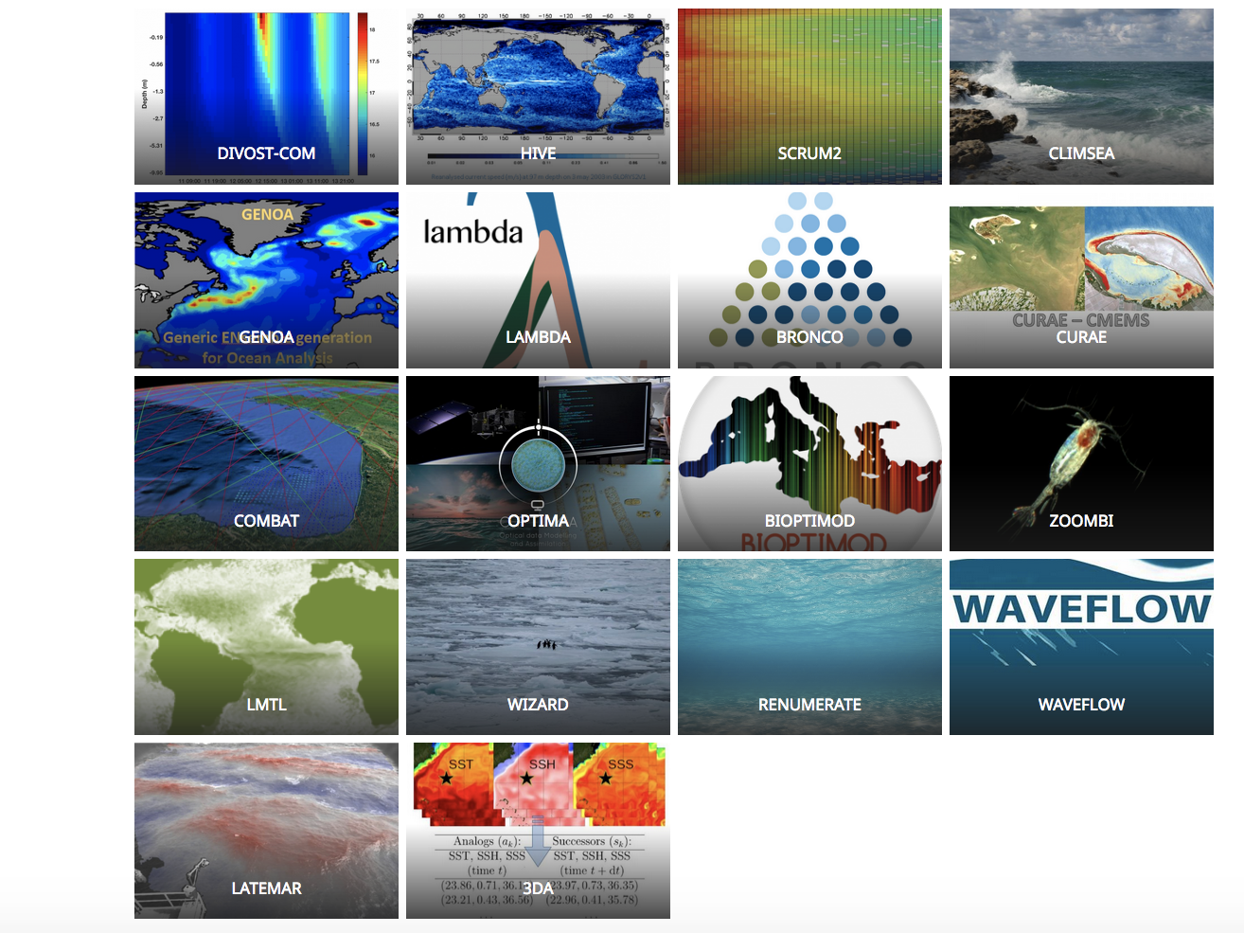
Service Evolution Tier 2: 2nd batch of R&D projects
Call for tenders : Q4 2017
Submitted projects
Evaluation (STAC + external reviews)
Choice Committee
18 Projects funded
2-yr contracts [2018-2020]
Total budget: 3 M€
PIs from 10 EU countries
5 main thematics covered + identified R&D priorities + emerging CMEMS needs
http://www.mercator-ocean.fr/mercator-ocean/copernicus/service-evolution/

Slide 5
CMEMS Service Evolution : Reporting / Meetings
Quarterly Reports
Quarterly Reports
REPORTS
Mid-Term Report
Final Report
A | M | J | J | A | S | O | N | D | J | F | M | A | M | J | J | A | S | O | N | D | J | F | M
2018 |  |  |  |  |  |  |  |  | 2019 |  |  |  |  |  |  |  |  |  |  |  | 2020
A | M | J | J | A | S | O | N | D | J | F | M | A | M | J | J | A | S | O | N | D | J | F | M
Mid-Term Meeting
EGU
CMEMS GA
Final Meeting
1st SE coord.
meeting
2nd SE
coord. meeting
MEETINGS
Objective: foster the uptake of R&D by CMEMS observation and modelling centers (TACs and MFCs):
Present projects and results to CMEMS TACs and MFCs leaders, and STAC,
Interact directly with them (as well as with PIs of the other projects),
Discuss the potential uptake of R&D activities and results by TACs MFCs.

Slide 6
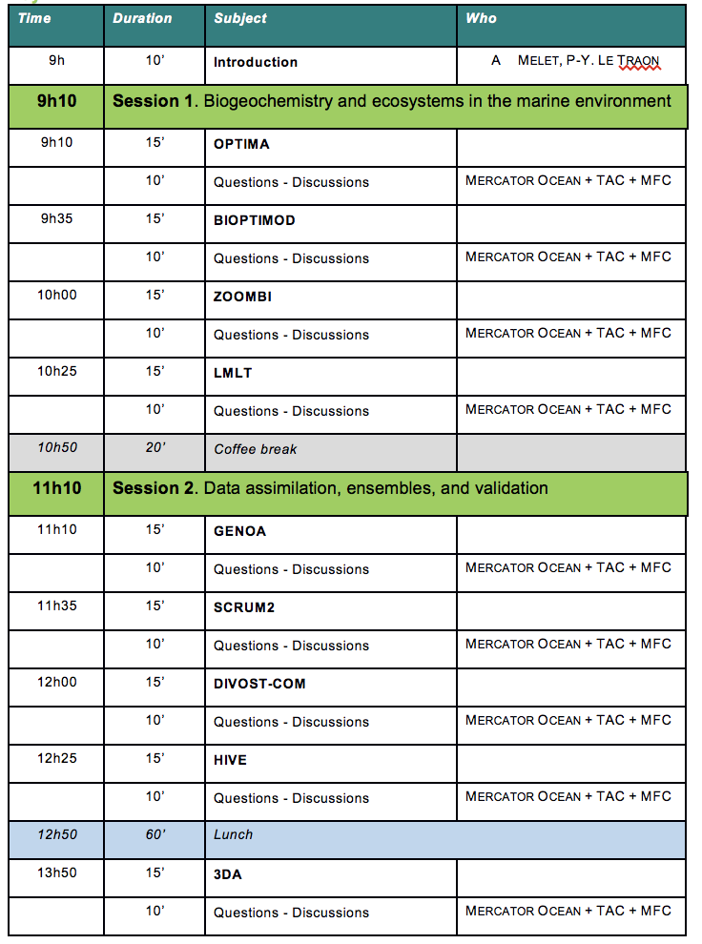
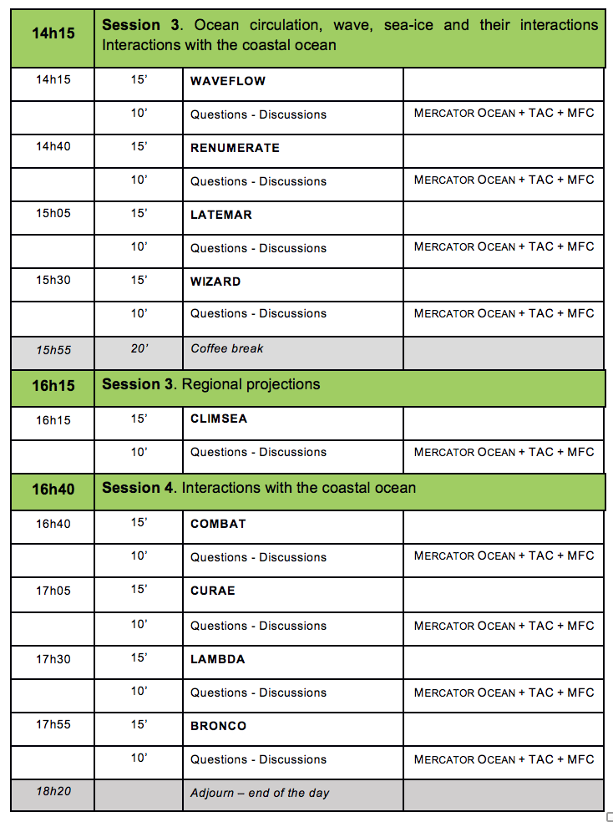
Agenda
BIODAWG this afternoon
Lunch at 12h30

